Slide 1
A Personal Evolution: From an Unbeliever to an Advocator Omar Dary 7-January-2011 Conference on Micronutrient Fortification of Foods: Science, Applications & Management

Slide 2
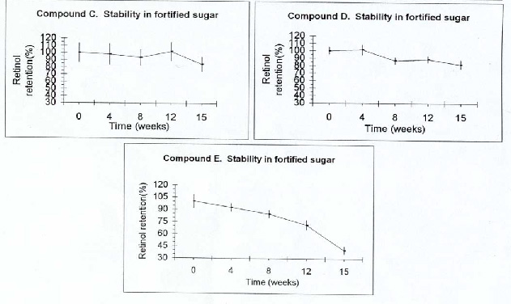
Stability of vitamin A in fortified sugar

Slide 3
Stability of vitamin A in products
If nutrients are of good quality, they are highly stable during storage and during food preparation; only a few chemical processes are highly deleterious.

Slide 4
Evolution of nutritional blindness
Source: National Committee for Blind and Deaf of Guatemala
Start of sugar fortification with vitamin A
1980 1982 1984 1986 1988 1990 1992 1994 1996 1998

Slide 5
Examples of successful food fort. programs
Food | Place | Nutrient | % Price Product | % EAR¹
Salt (10 g day) | Worlwide | Iodine | 0.3 % | 198 %
Sugar (80 g/day) | Central America | Vitamin A | 2.3 % | 112 %
Wheat Flour (200 g/day) | Chile, RSA, USA, Canada | Folic Acid | 0.05% 0.6 %² | 88 %
¹ EAR for women of reproductive age
² Plus other micronutrients (Complete formula)

Slide 6
Assessing the need and the solutions
Need (assessment):
Size of nutritional gap
Percent of the people affected
Solutions (science):
Correction of inadequate intake (bioefficacy)
Coverage: Percent of people who receive the benefit

Slide 7
Potential impact of fortification with vit.A
% Children (24-59 months) with intakes below the EAR values in Uganda - 2008

Slide 8
Potential impact of fortified w. flour in Kampala
% Women (15-49 years) with intakes below the EAR values

Slide 9
Estimated impact on intakes of fortified w. flour
Palestinian women of Hebron and Gaza City - 2005
Formula also contains vitamin D, which appears to be the main nutritional clinical deficiency of women.

Slide 10
Estimated impact on intakes of fortified w. flour
Palestinian women of Hebron and Gaza City - 2005

Slide 11
Folate and B₁₂ in Palestinian communities
Source: UNRWA, Juzoor, and Ministry of Education of the Palestinian Authority.
West Bank – 2009 – school-age females
Nutrient/ Indicator | Bethlehem | Ramallah | Nablus
Folate >45.3 nmol/L (supra-physiological) | 11 % | 22 % | 33 %
Vit. B₁₂ > 221 pg/mL (sufficiency) | 60 % | 82 % | 87 %
Betlehem has lower access to fortified wheat flour.

Slide 12
Success: Clear definition of responsibilities
Safe, Efficacious and Sustainable
MAIN PLAYERS
Researchers, Economists, Statisticians
Cost-Effectiveness Analysis
Cost-Effectiveness Analysis
Nutrition Researchers, Statisticians, Laboratories
Impact Assessment
Impact Assessment
Food industry, Marketing, Government Guidance
Social Marketing and Education
Food Control from MoH, M.Economy, Food Labs
Governmental Inspection and Auditing
Food Industry – QC/QA Department
Quality Control & Assurance - Factories
Food Industry/ Production Dept.
Implementation and Production
Premix manufacturers
Implementation and Production of Micronutrient Premixes
Bureau of Standards
Standards and Regulations
Central Government
Policies and National Strategies
Nutrition and Researchers
Science (Efficacy trials) and Epidemiological Assessment
Science (Efficacy trials) and Epidemiological Assessment
A good product and a successful efficacy trial do not make a program

